Slide 1
A BRIEF HISTORY OF THE INTERNET

Slide 2
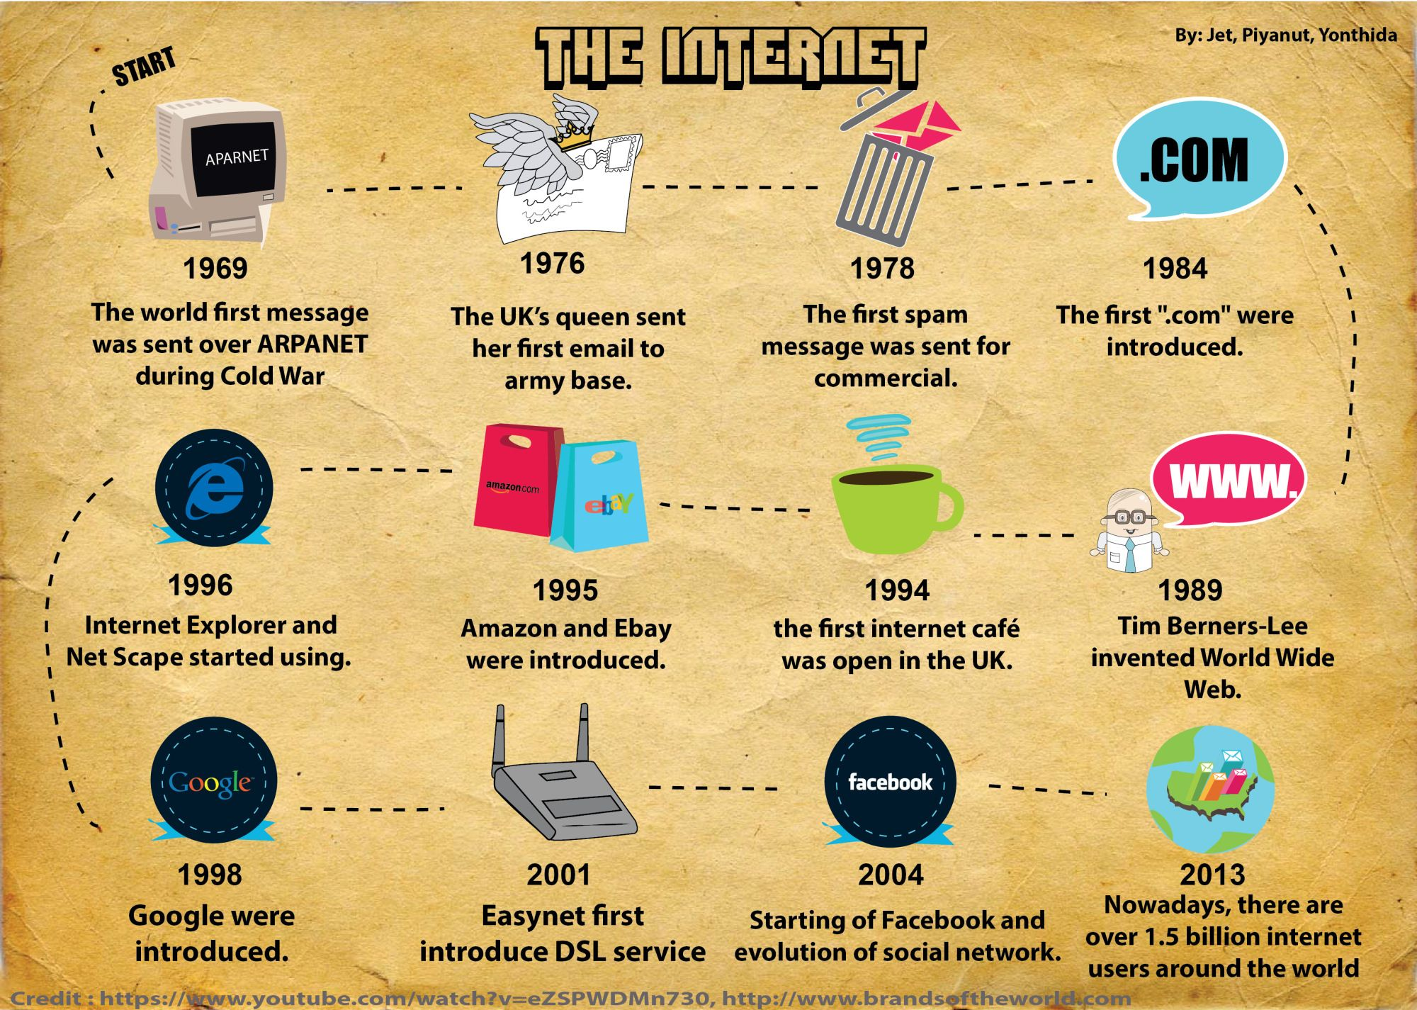

Slide 3
History of internet
In the beginning … there was no Internet.
In fact, the original concept of an Internet did not include commerce, global connectivity, or public usage.
The initial concept of such was derived due to government suspicion and social hysteria during 1960s.
The threat of nuclear war and mass destruction was such that government entities focused on developing electronic communication systems that would be capable of working successfully even if large portions were somehow destroyed.
The beginning was a project of the Advanced Research Project Agency Network (ARPANet) sponsored in 1969 by the Department of Defense.
It was primarily designed to overcome threats from a blackout of communication in the event of a nuclear war.
This computer network linked four universities (UCLA, Stanford, UC Santa Barbara, and the University of Utah) and was intended to facilitate communications between computers over phone lines regardless of system characteristics.
Initially used by researchers, engineers, computer experts, and the like, the system proved to be rather complicated. Interactive sessions were not possible.

Slide 4
Cont …
The first RFC (RFC0001) was written on April 7, 1969. There are now well over 2000 RFCs, describing every aspect of how the Internet functions.
ARPANet was opened to nonmilitary users later in the 1970s.
International connections (i.e., outside America) started in 1972, but the “Internet” was still just a way for computers to talk to each other and for research into networking; there was no World Wide Web and no e-mail as we now know it.
By the mid-1980s, this network was further expanded with the introduction of the NSF Net, established under the National Science Foundation by a small group of super computer research centers and researchers at remote academic and governmental institutions.

Slide 5
Cont …
This network was highly supported by the government, which encouraged researchers and institutions to avail themselves of this communication tool. This collaboration led to the development of both online and offline computer communities, as well as the creation of a myriad of software which included.
UNIX OS (developed by Bell Laboratories).
Mosaic Interface (a multimedia interface for information retrieval).
Eudora (an e-mail system), contributed by the University of Illinois.
Gopher (information retrieval tool), contributed by the University of Minnesota.
Pine (e-mail), University of Washington.
CU-SeeMe (low-cost video conferencing), Cornell.

Slide 6
Cont …
By the mid-1980s, the Commercial Internet Xchange (CIX) had emerged, and midlevel networks were leasing data circuits from phone companies and subleasing them to institutions. Eventually, this small network had expanded into networks of networks, until the contemporary phenomenon known as the Internet emerged.
The concept of “domain names” (e.g., www.microsoft.com) was first introduced in 1984. Prior to this introduction, computers were simply accessed by their IP addresses (numbers).
World Wide Web is a collection of hyperlinked pages of information distributed over the Internet via a network protocol called hypertext transfer protocol (HTTP). This was invented in 1989 by Tim Berners-Lee, a physicist working at CERN, the European Particle Physics Laboratory, who created the Web so that physicists could share information about their research. Thus, the Web was introduced as a restricted means of communication between scientists. Although it was originally a text-only medium, graphics were soon introduced with a browser called NCSA Mosaic. Both Microsoft’s Internet Explorer and Netscape were originally based on NCSA Mosaic.

Slide 7
Cont …
This graphical interface opened up the Internet to novice users and in 1993.
Prior to the developments, the computers were connected at universities and other large organizations that could afford to wire cables between each other to transfer the data over.
Currently, there are several quick and inexpensive ways to connect to the Internet. At the minimum, users simply need a computer, a modem, a telephone line, and inter computer communication software. These basics allow users to connect via ISPs.
New trends, however, reveal that consumers are increasingly attracted to service-oriented ISPs, sometimes referred to as “online service providers (OSPs).”
The Internet has grown exponentially in the past three decades.

Slide 8
RECOGNIZING AND DEFINING COMPUTER CRIME
There are three general categories of computer crime: targets, means, and incidentals.
For example, insiders may target a computer system for destruction due to perceptions of mistreatment, and, at the same time, may use the computer as a means of committing embezzlement.
In hacking activities, one computer provides the means for the criminal activity, while another serves as the target.
Finally, an individual may improperly gain access to a computer (i.e., unauthorized use) to steal information which resides therein. Thus, she or he would be targeting a computer, while also using it as an instrument to commit criminal activity.
it is unclear exactly when and where the first “computer crime” actually occurred.
Contextually, theft of an abacus or a simple adding machine would constitute a computer crime. It is safe to assume that these types of activities occurred long before written or formal documentation was in vogue.

Slide 9
Cont …
• However, the first documented instance of computer sabotage occurred in the early nineteenth century, when a textile manufacturer named Joseph Jacquard developed what would soon become the precursor to the computer card.
His invention, which allowed automation of a series of steps in the weaving of special fabrics, was not popular among his workers, who feared for their continued employment.
Thus, they dismantled his invention. Unfortunately, such discussion does not adequately establish definitional parameters for criminal activity involving computers.
In fact, not all crimes involving computers can be characterized as “computer crime.”

Slide 10
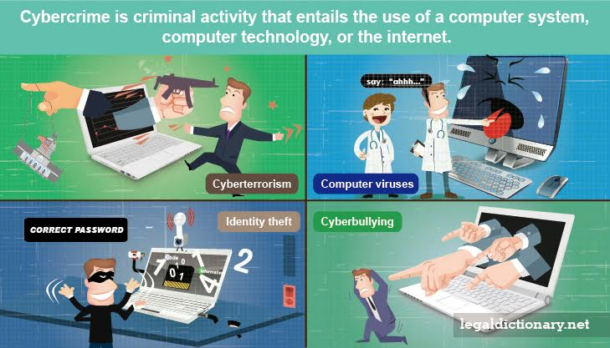

Slide 11
Cont …
It would be inappropriate, for example, to categorize a residential burglary as a computer crime, even if a computer was among the items stolen. At the same time, the hijacking of an entire shipment of computer hard drives is more appropriately situated elsewhere.
And, finally, the theft of millions of dollars via computer hacking is most properly denoted as a “cybercrime.”
A general term that has been used to denote any criminal act which has been facilitated by computer use. Such generalization has included both Internet and non-Internet activity. Examples include theft of components, counterfeiting, digital piracy or copyright infringement, hacking, and child pornography.

Slide 12
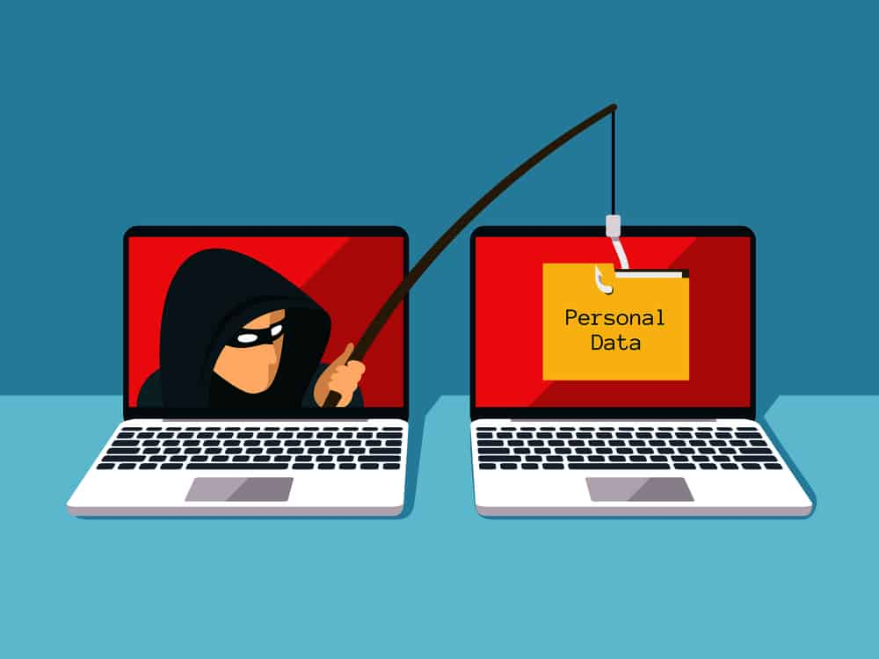
Phishing

Slide 13
COMPUTERS AS A TARGET, CONTAMINANTS AND DESTRUCTION OF DATA
When a computer is the target of crime, the attacker attacks the computer by breaking into it or attacking it from outside.
This is the most professional as comparing to cybercrime, because the criminal does programming and makes use of some exploits on computer, who always has pretty strong professional background of computer science.
This type of cyber-crimes are committed only by a selected group of cyber criminals.
These crimes require the technical knowledge of the cyber criminals as compared to crimes using the computer as a tool.
The main purpose of committing these cybercrimes is to directly cause damage to a computer system or to access the important data stored in a computer.

Slide 14
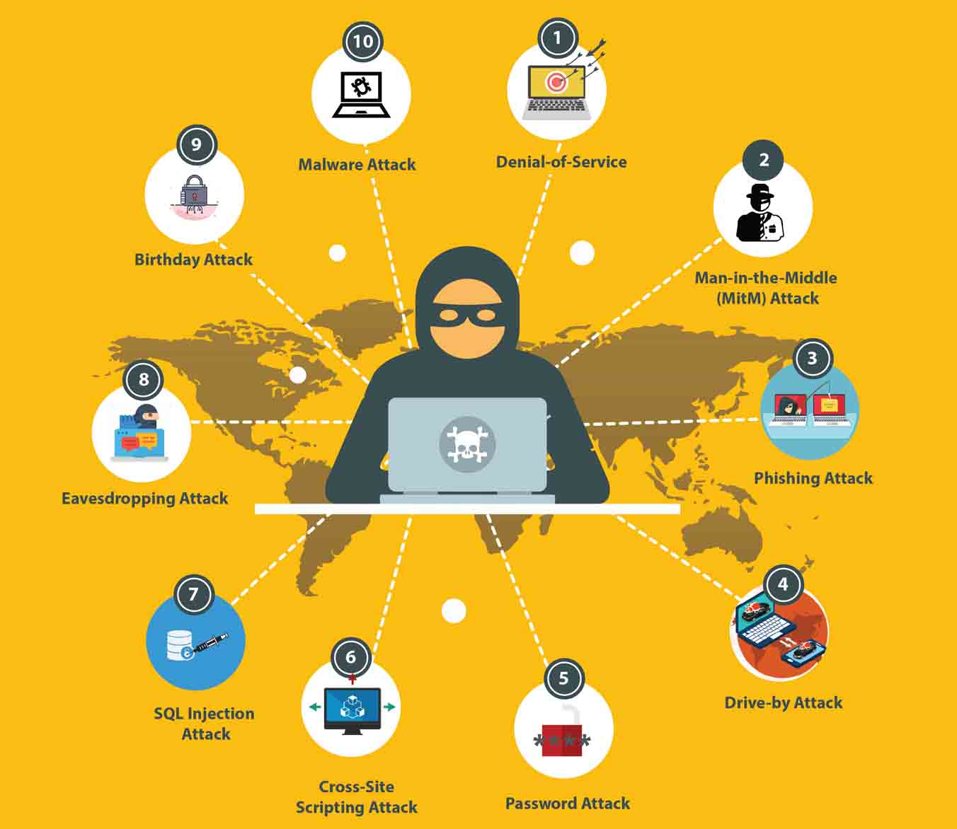
cybercrimes

Slide 15
Cont …
This includes stealing data or information from system, theft of computer software, blackmailing based on persons information gained from computer etc.
Intellectual Property Theft;
Marketable information theft;
Theft of data/information;
Sabotage of computer, computer system or computer networks;
Unlawful access to government records and criminal justice etc.

Slide 16
Thank you

